Slide 1
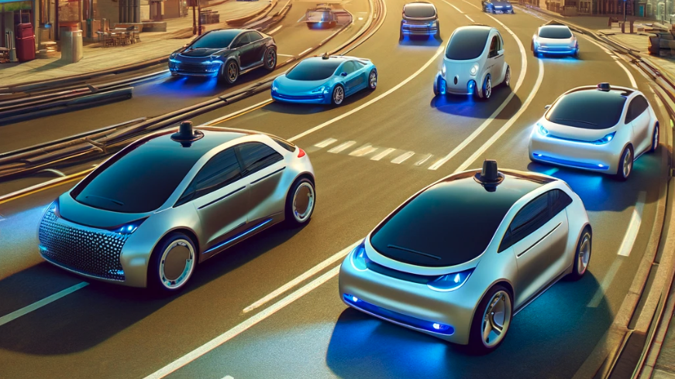
AI FOR ENGINEERING DESIGN PROJECT 2 MONITOR VEHICLE HEALTH AND PREDICT FAULTS
Presented by:
Kheesheshta Ramgoolam Sobun
Safinaz Khalil
Sorna Raj Shanmuga Raja
Atsegadho Clement Togharano

Slide 2





Problem Statement
BROAD VIEW: Monitor Vehicle Health & Predict Faults
Addressing this pivotal gap, research paper unveils EngineFaultDB
M. Vergara, L. Ramos and N. D. Rivera-Campoverde, “EngineFaultDB: A Novel Dataset for Automotive Engine Fault Classification and Baseline Results,” IEEE Access, vol. 11, pp. 126155 - 126171, 2023.
Importance of Vehicle Health Monitoring
Significance of Predicting Faults
Focus on Engine
Preference for IC over Electric Engines
Traditional Techniques to AI / ML
SAFETY
Ensuring vehicle health is paramount for preventing accidents and safeguarding road users.
COST-EFFICIENCY
Predictive maintenance lowers repair costs and prevents potential revenue losses
CRITICAL COMPONENT
The engine's condition directly impacts vehicle reliability, performance, and overall safety.
ENVIRONMENTAL IMPACT & REAL WORLD APP
Their emissions have a direct impact on Environment leading to Air Pollution.
ENHANCED SAFETY
AI/ML-driven engine diagnostics improve safety by identifying potential issues before they escalate.
NARROW VIEW: Automotive IC Engine Fault Classification towards Fault Predictions
Notes:
The stakes are high:When vehicles are regularly monitored for health, potential issues can be detected early, reducing the risk of accidents attributed to mechanical failures. This proactive approach to maintenance not only preserves the integrity of the vehicle but also the safety of its occupants and others on the road.
Predictive maintenance utilizes data-driven insights to preemptively address vehicle issues before they lead to failure. This foresight is more than just a technical convenience—it is a financial strategy.
By anticipating and rectifying faults early, the costs associated with vehicle repair are significantly diminished.
5. Traditional techniques for engine fault diagnosis have relied heavily on scheduled maintenance and reactive repairs. Mechanics would often use manual diagnostics, which depended on observable symptoms, experience, and standard checklists to identify issues.The advent of AI and machine learning (ML) technologies has ushered in a transformative era for vehicle diagnostics.AI/ML algorithms have the capacity to learn from vast amounts of data, including real-time performance metrics, to identify patterns and anomalies that are imperceptible to the human eye. They are predictive, capable of forecasting potential engine faults before they manifest into costly and dangerous failures

Slide 3
Overview of the Project
Start
Create Neural Network
Plot Training History
Obtain Dataset
Evaluating Models
Training of ML algorithm
Dataset Visualisation
Create ML Algorithm(Classical)
Accuracy
Load & Pre-process data
Important Features
Confusion Matrices
Model Comparison
END
Split Dataset

Slide 4
Variables/ Parameters of Dataset
Variable | Variable Name | Role
1 | MAP (kPa) | Manifold Absolute Pressure, critical for fuel injection and timing control (kiloPascals).
2 | TPS (%) | Throttle Position Sensor, influencing fuel injection and engine parameters (percentage).
3 | Force (N) | Engine torque or rotational force (newtons).
4 | Power (kW) | Engine work rate or energy transfer (kilowatts).
5 | RPM | Engine speed in revolutions per minute.
6 | Fuel consumption l/h | Rate of fuel consumption per hour (liters per hour).
7 | Fuel consumption l/100km | Fuel efficiency over a specified distance (liters per 100 kilometers).
8 | Speed (km/h) | Vehicle travel speed (kilometers per hour).
9 | CO (%) | Carbon Monoxide concentration in exhaust gases (percentage).
10 | HC (ppm) | Hydrocarbons concentration in exhaust (parts per million).
11 | CO2 (%) | Carbon Dioxide concentration in exhaust, indicating combustion efficiency (percentage).
12 | O2 (%) | Oxygen content in exhaust, reflecting combustion process (percentage).
13 | Lambda | Air-fuel equivalence ratio, comparing actual mixture to stoichiometric ratio.
14 | AFR | Air-Fuel Ratio, ratio of air to fuel in combustion chambers

Slide 5
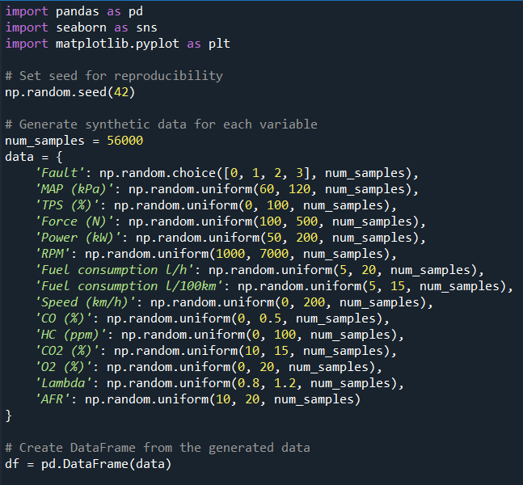
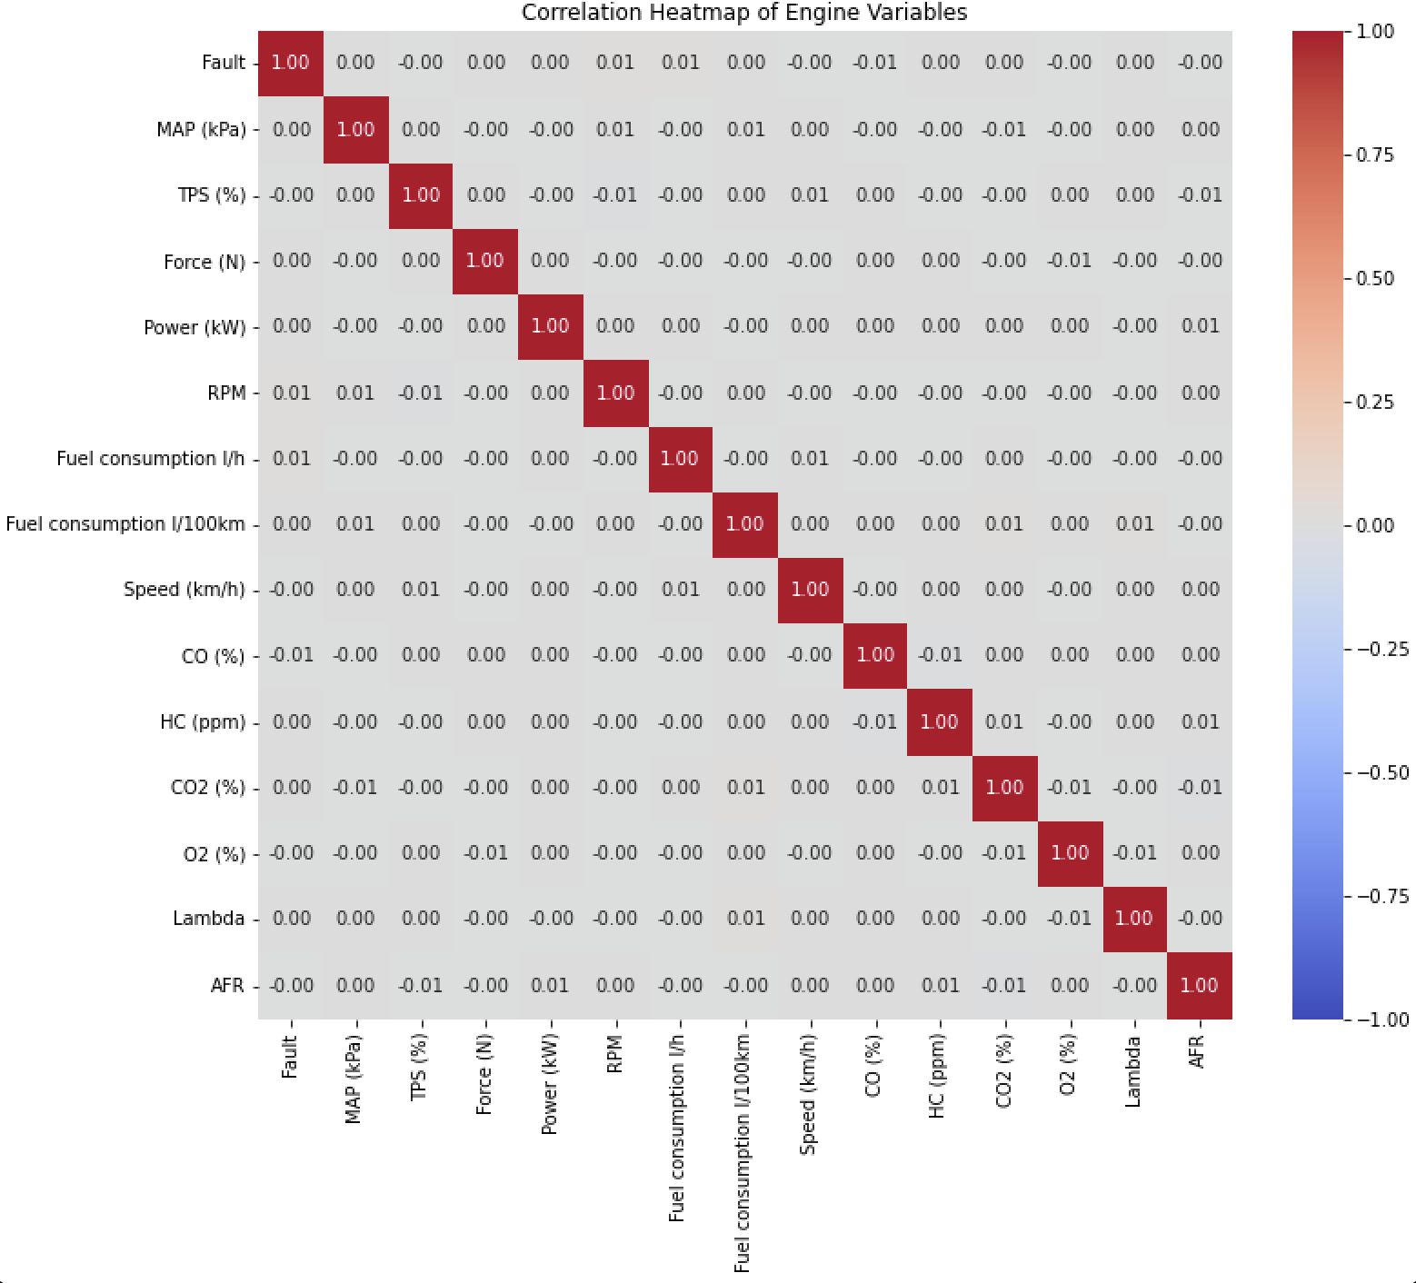
Synthetic Dataset Generated
Heatmap of the correlation
Vey Less Accuracy of 25%
REALISM: Does Not fully capture the complexity and variability of real-world data.
OVERFITTING: May overfit and perform poorly on real-world data.
Machine Learning Algorithms

Slide 6
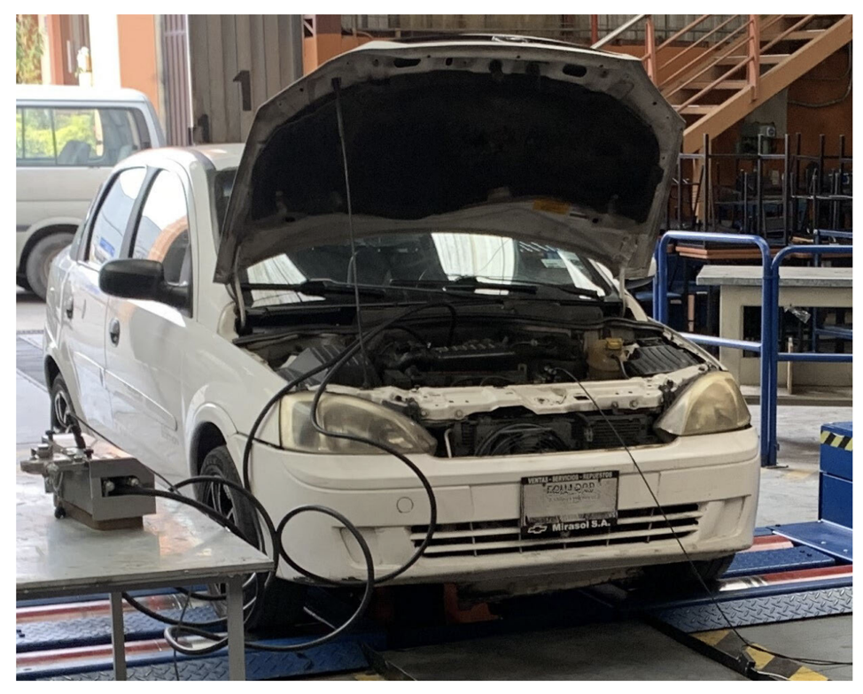

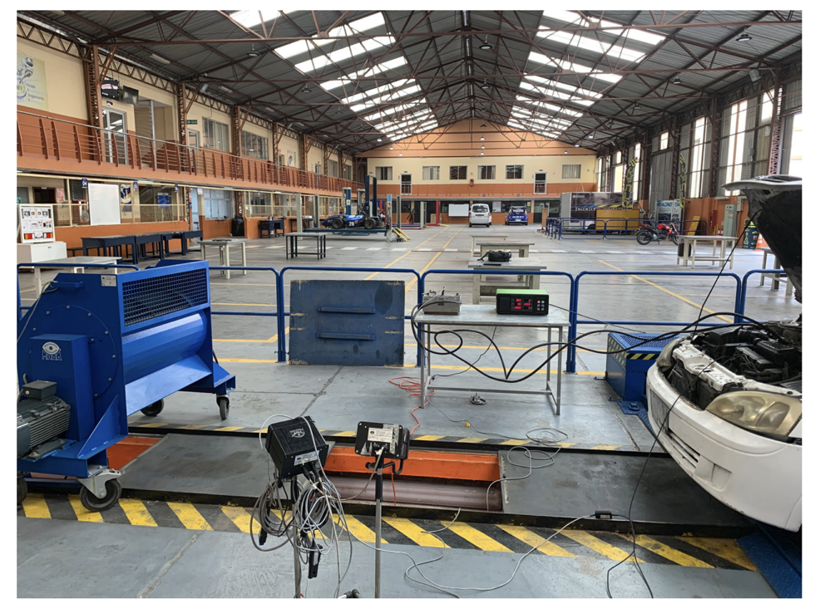


Real Time Dataset
Methodology used for EngineFault DB Formation
Fault Categorisation
The dataset contains 55,999 entries classified into 4 categories representing different fault type.
The dataset is captured through its 14 distinct variables
Dataset Formation
Car
Engine
Fault Type | Fault Name | Conditions
Fault 0 | ALL OK | NA
Fault 1 | Rich Mixture | Incorrect Sensor Performance High Fuel Pressure Defective Injector Faulty pressure regulator Clogged Air Filter Clogged Fuel return line
Fault 2 | Lean Mixture | Incorrect Sensor Performance Low fuel pressure Defective Injector Faulty Pressure Regulator
Fault 3 | Low Voltage | Worn Spark Plugs Fault Igcognition cables Defective Coil Faulty Sensor Wiring
C14NE
spark
ignition
petrol
DATASET
Data Integrity
Failure Induction
Data Meas
NGA 6000 gas analyzer
USB 6008 data acquisition
M. Vergara, L. Ramos and N. D. Rivera-Campoverde, “EngineFaultDB: A Novel Dataset for Automotive Engine Fault Classification and Baseline Results,” IEEE Access, vol. 11, pp. 126155 - 126171, 2023.
Notes:
Tools and equipment : C14NE spark ignition engine
harmful emissions in exhaust gases (carbon monoxide, hydrocarbons, Carbon dioxide )of vehicles measured by the NGA 6000 gas analyser
All the setup and experimental procedures were meticulously assembled and conducted in a university laboratory setting,

Slide 7
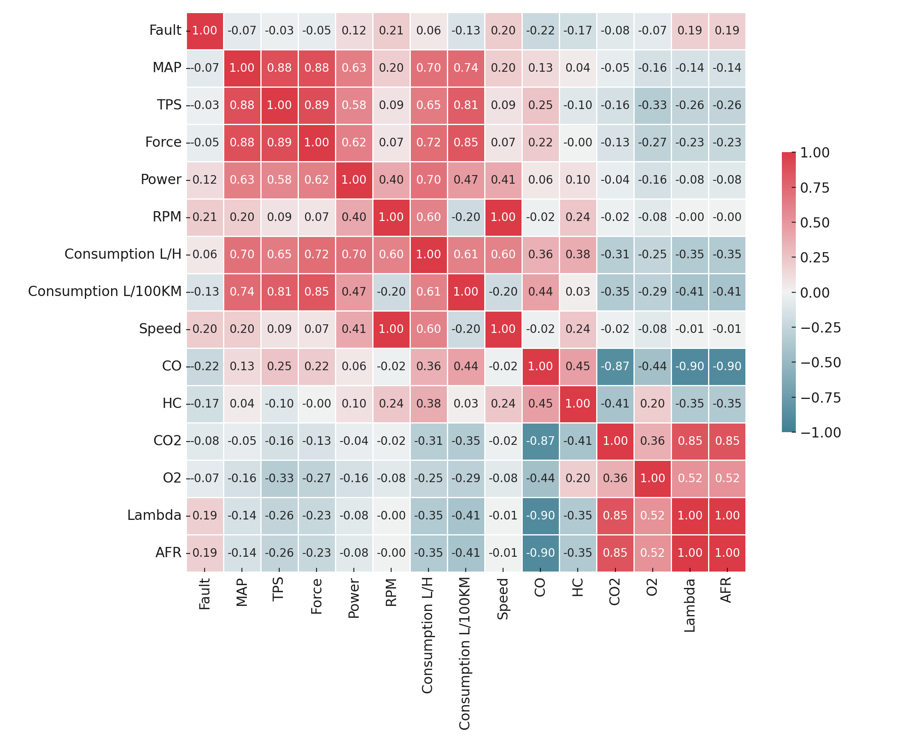
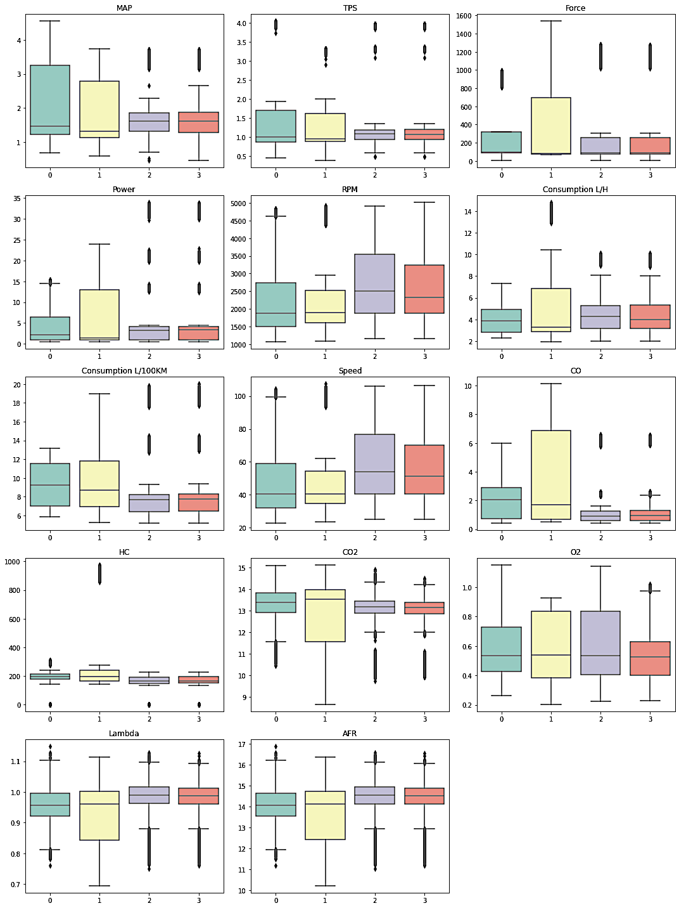
Data Visualisation
Overview of the Project
Heatmap of the correlation of Engine Fault DB variables
Boxplot
High positive correlation (values closer to 1): two variables increase or decrease together.
high negative correlation (values closer to -1): One variable increases, the other tends to decrease.
A value close to 0 suggests there is no relationship between the variables.
BOX: interquartile range (IQR), which is the middle 50% of the data.
CENTRELINE: within the box represents the median value.
OUTLIERS: Data points that fall outside a certain range of the IQR.

Slide 8
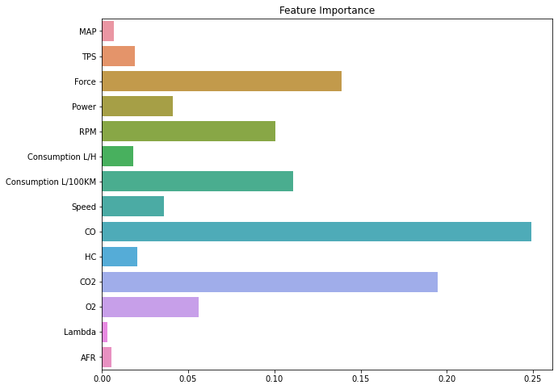
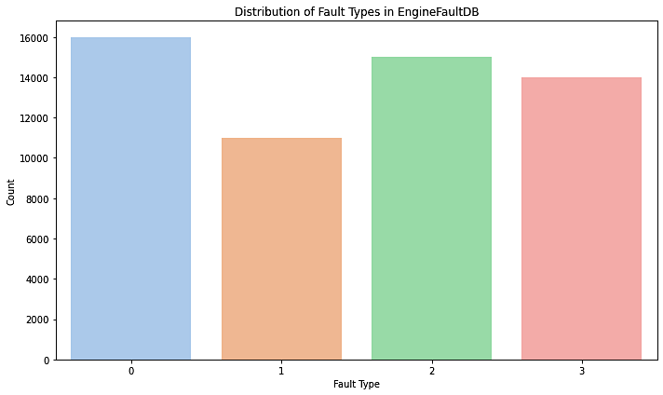
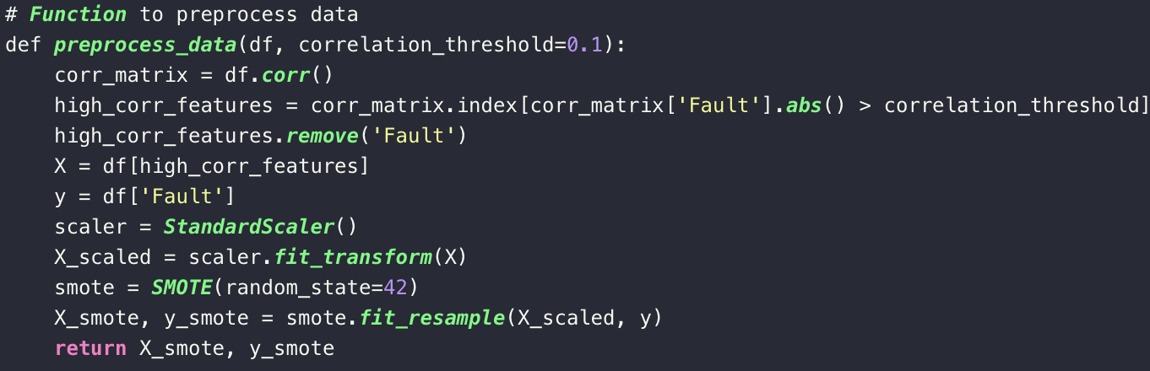
Load & Pre-Process Data
Overview of the Project
Feature Engineering
Separate features and target variable, ‘Fault’
Scale the Features
Apply ‘Smote’
Notes:
Feature Engineering: The function preprocess_data employs a correlation threshold to select features for the model.
This is a form of feature selection, an important aspect of feature engineering. It identifies and retains only those features that have a significant correlation (above a specified threshold) with the target variable 'Fault’.
This helps in reducing the dimensionality of the dataset, potentially improving model performance by excluding irrelevant or less significant features.
Data Scaling: The script uses StandardScaler to standardize the features of the dataset. Standardization (or Z-score normalization) is the process whereby the features are rescaled so that they have the properties of a standard normal distribution with a mean of 0 and a standard deviation of 1.
Handling Imbalanced Classes with SMOTE: The SMOTE (Synthetic Minority Over-sampling Technique) is applied to the dataset to address class imbalance. This is an advanced form of data augmentation for the minority class. SMOTE works by creating synthetic examples rather than over-sampling with replacement. This is particularly useful in classification problems where one or more classes are underrepresented.
GAP: Fault 2 is underrepresented .

Slide 9
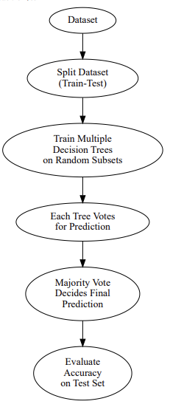
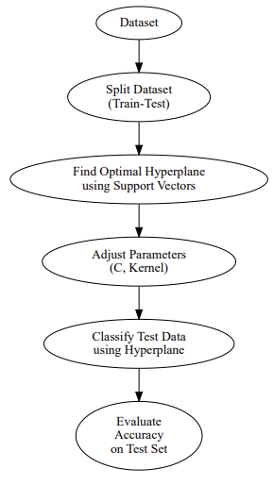
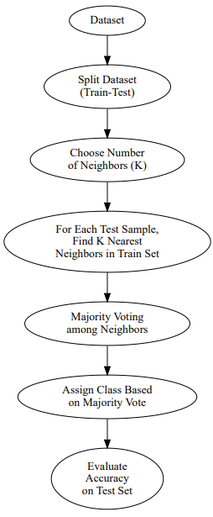
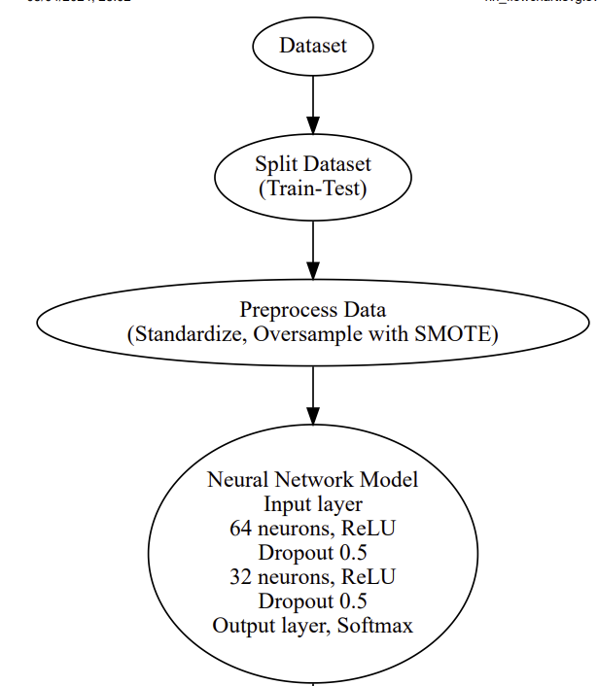
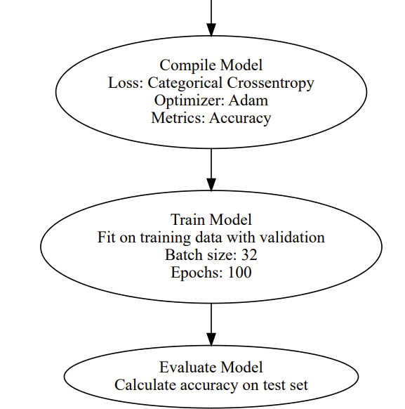
Improvements on Previous Work
Overview of the Project
Random Forest
SVM
KNN
Feedforward

Slide 10
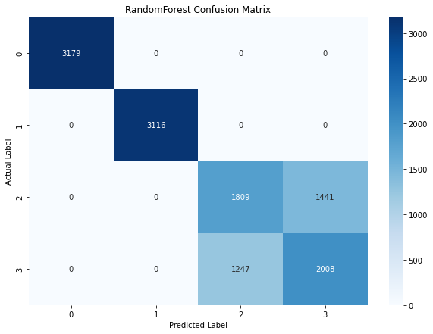
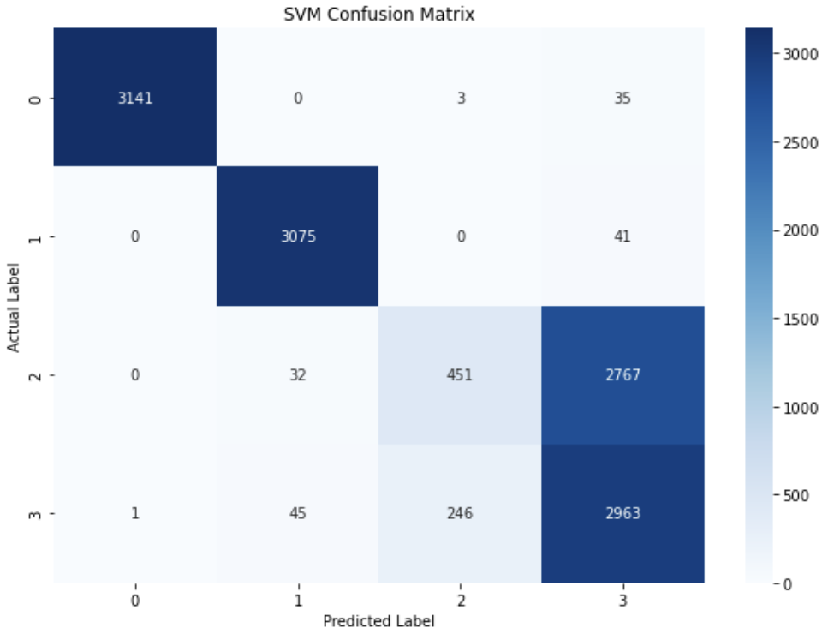
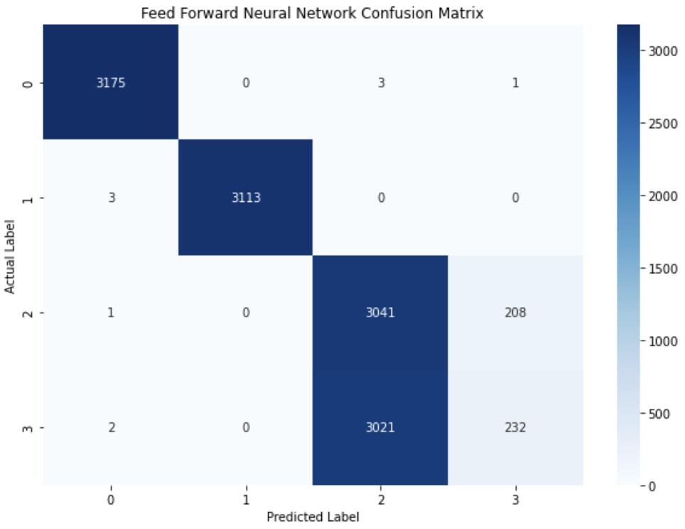
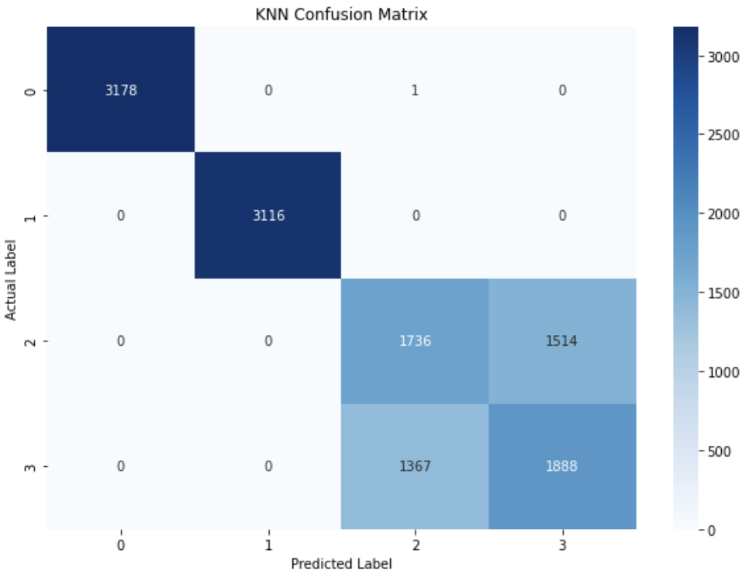
Results & Analysis (Improvements)
Overview of the Project
ML algorithm | Accuracy from Research Work | Accuracy from our work | Analysis Improvement in %
Random Forest | 0.748 | 0.790 | 5.61%
SVC | 0.746 | 0.763 | 2.28%
KNN | 0.751 | 0.783 | 4.26%
Neural Network | 0.749 | 0.754 | 0.67%

Slide 11
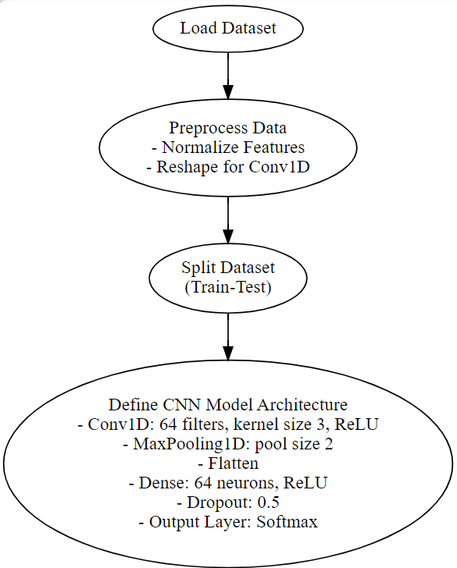
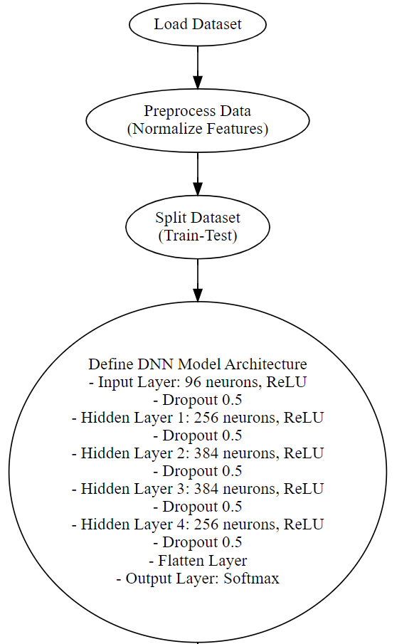
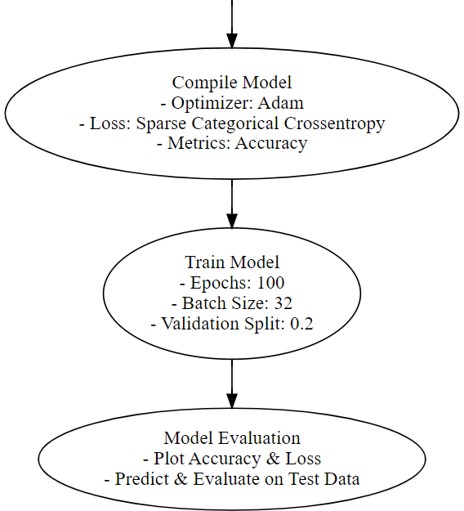
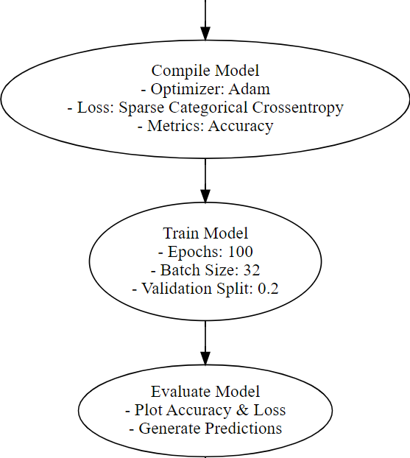
Our Advanced Work
CNN Structure
DNN Structure
Reshape for Conv1D(samples, time steps, features)
Dense Layer
96 Units
Activation: ReLU
Dropout Layer
Rate: 0.5
Conv1D Layer 64 filters, Kernel Size 3
Activation: ReLU
Dense Layer
256 Units
Activation: ReLU
Dropout Layer
Rate:0.5
Max Pooling Layer
Pool Size 2
Deanse Layer
384 Units
Activation: ReLU
Dropout Layer
Rate:0.5
Flatten Layer
Deanse Layer
384 Units
Activation: ReLU
Dropout Layer
Rate:0.5
Deanse Layer
64 Units
Activation: ReLU
Dropout Layer
Rate:0.5
Dense Layer
256 Units
Activation: ReLU
Dropout Layer
Rate: 0.5
Flatten Layer
Deanse Layer
4 Units (Classes)
Activation: Softmax
Dense Layer
N classes
Activation: Softmax

Slide 12
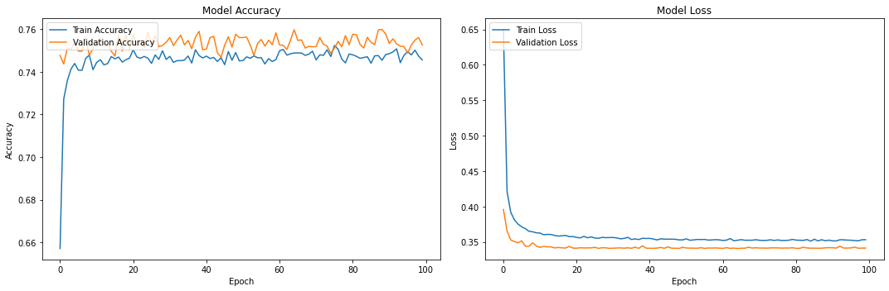
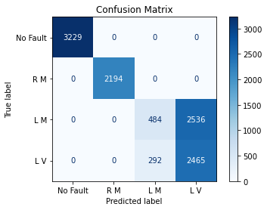
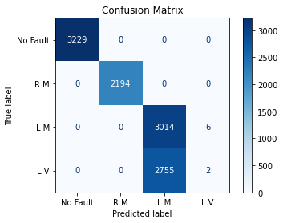
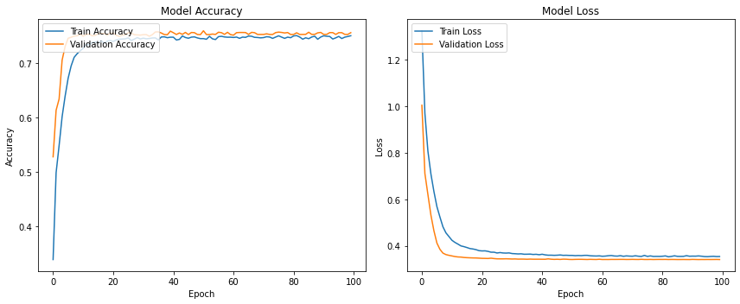
Results & Analysis (Advanced Work)
Model performance for the CNN algorithm: 76.5% accuracy
Model performance for the DNN algorithm: 75.5% accuracy

Slide 13
Conclusion and Future Works
Expanding Datasets
Enriching these data with a wider range of fault types and additional variables like vibration metrics will provide deeper insights into engine diagnostics and maintenance.
1
Different Engines
Broadening the research by curating datasets for different engine types, such as diesel engines and Electrical Engines
2
3
Hybrid Approach
Combination of ML and DL techniques (e.g., using pre-trained DL models for feature extraction followed by an ML classifier) can yield optimal results
Implementing Real-time
Collaborations with industry partners could lead to the practical application of this findings.
4

Slide 14
Overview of the Project
THANK YOU

